Slide 1
<CSE 4126: Lab 01> <Distributed Database Systems Lab>
Faisal Muhammad Shah
G. M. Shahariar
<Department of Computer Science & engineering>
<Ahsanullah University of Science & Technology>

Slide 2
Objective
Software Installation
Introduction to PL/SQL
Work on SQL*PLUS
Execute SQL commands via scripts
Create PL/SQL anonymous block structure, declare variable and execute a statements inside the block.

Slide 3
Software – Oracle 10g, SQL*PLUS
Software Installation – Follow “Installation Procedure.pdf”
Prerequisite – Relational Schema, SQL, C, C++
Reference –
http://www.plsqltutorial.com/
https://www.w3schools.com/sql/sql_intro.asp
(For SQL revision)

Slide 4
Pl/SQL
PL/SQL is a Procedural Language (PL) that extends the Structured Query Language (SQL).
It is difficult to write applications using SQL only because each SQL statement runs independently and has little or no effect on each other. To overcome this limitation, you often have to use other programming languages (such as C#, PHP, and Java) as frontend.
Oracle, an object-relational database management system produced by Oracle Corporation, supports this approach when you want to develop applications that interact with Oracle databases.

Slide 5
Software Installation
Follow “Installation Procedure.pdf”

Slide 6
Getting Started
C:\oraclexe\app\oracle\product\10.2.0\server\BIN

Slide 7
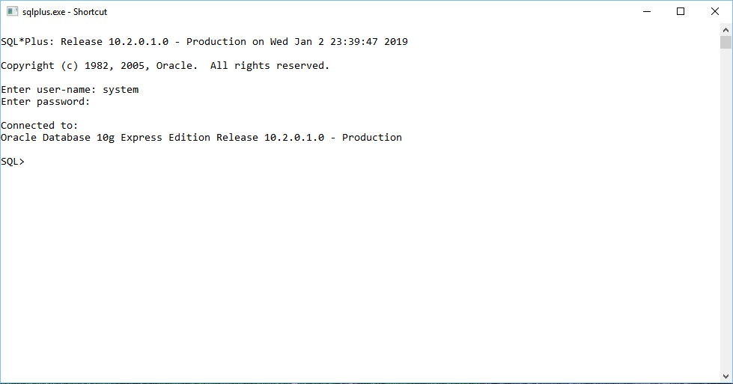

Slide 8
Type: select * from dual;

Slide 9
Revising Basic SQL Commands
DDL (Data Definition Language) :
CREATE
DROP
ALTER
TRUNCATE
COMMENT
RENAME
DML (Data Manipulation Language) :
SELECT
INSERT
UPDATE
DELETE

Slide 10
CREATE TABLE student (id number(20), name varchar2(20), semester integer, date_of_birth date);
INSERT INTO student VALUES(1, 'Rahim', 1, '10-oct-1990');
INSERT INTO student VALUES(1, Karim, 2, '12-oct-1990');

Slide 11
Changes made to the database by INSERT, UPDATE and DELETE commands are temporary until explicitly committed. This is performed by the command.
commit;
To drop a table,
drop table student;

Slide 12
create table student (id number(20), name varchar2(20), semester integer, date_of_birth date, primary key(id));
insert into student values(1, 'Rahim', 1, '10-oct-1990');
insert into student values(2, 'James', 2, '11-jan-1990');
insert into student values(3, 'Jamal', 3, '13-mar-1990');

Slide 13
create table student_result (id number(20), cgpa number(6,5), foreign key (id) references student(id));
insert into student_result values(1, 3.99);
insert into student_result values(2, 3.85);
insert into student_result values(3, 2.99);
commit;

Slide 14
drop table student cascade constraints;
drop table student_result cascade constraints;

Slide 15
Executing SQL Commands via Scripts
@ F:/Distrubuted_Database/CSE_4126/Lab1/Codes_session_1/QUERY/table.sql;
@ F:/Distrubuted_Database/CSE_4126/Lab1/Codes_session_1/QUERY/insert.sql;

Slide 16
define dr=F:/Distrubuted_Database/CSE_4126/Lab1/Codes_session_1/QUERY
@ &dr/table.sql;
@ &dr/insert.sql;
Comments:
/* for multiple lines */
-- for single line

Slide 17
Join:
@ &dr/join.sql;
Sub-query:
@ &dr/subquery.sql;
Set:
@ &dr/set.sql;

Slide 18
View:
In SQL, a view is a virtual table based on the result-set of an SQL statement. A view contains rows and columns, just like a real table. The fields in a view are fields from one or more real tables in the database. You can add SQL functions, WHERE, and JOIN statements to a view and present the data as if the data were coming from one single table.
@ &dr/view.sql;
@ &dr/view2.sql;
@ &dr/viewup.sql;

Slide 19
PL/SQL
Block Structure
PL/SQL program units organize the code into blocks.
A block without a name is known as an anonymous block.
The anonymous block is the simplest unit in PL/SQL. It is called anonymous block because it is not saved in the Oracle database.
An anonymous block is an only one-time use and useful in certain situations such as creating test units.

Slide 20
syntax
[DECLARE]
Declaration statements;
BEGIN
Execution statements;
[EXCEPTION]
Exception handling statements;
END;
/

Slide 21
The declaration section allows you to define data types, structures, and variables. You often declare variables in the declaration section by giving names, data types, and initial values.
The execution section is required in a block structure and it must have at least one statement. The execution section is the place where you put the execution code or business logic code. You can use both procedural and SQL statements inside the execution section.
The exception handling section is starting with the EXCEPTION keyword. The exception section is the place that you put the code to handle exceptions. You can either catch or handle exceptions in the exception section.
Notice that the single forward slash (/) is a signal to instruct SQL*Plus to execute the PL/SQL block.

Slide 22
Let’s Start
define dr =F:/Distrubuted_Database/CSE_4126/Lab1/Codes_session_1/PLSQL
@ &dr/null.sql;
@ &dr/anonyblock.sql;

Slide 23
Variables
Declare:
@ &dr/variable.sql;
Anchors:
@ &dr/variable2.sql;
Assignment:
@ &dr/variable3.sql;
Initialization:
@ &dr/variable4.sql;

Slide 24
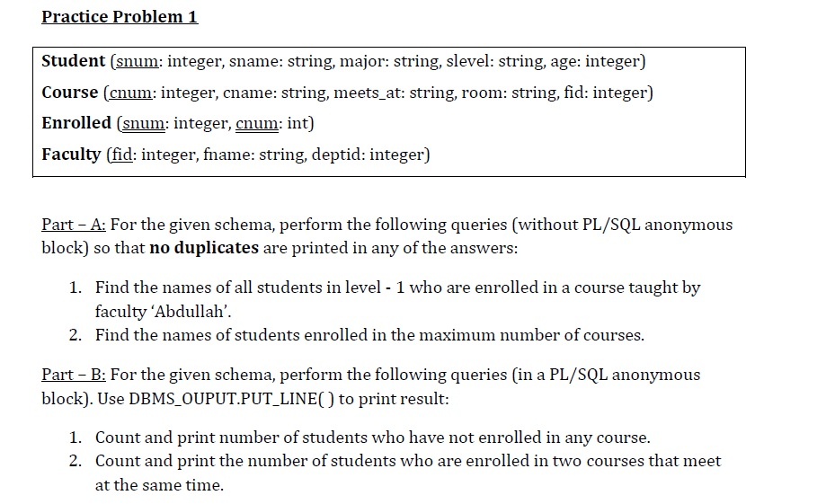

Slide 25
Thank You

